Slide 1

Nationally designated areas inventory
Reporting 2026
Mette Lund – 15 January 2026

Slide 2
Agenda
Welcome
Overview of the main changes/additions to the NatDA reporting format
Main steps for reporting strict protection and OECMs
Spatial data – incl mapping to the INSPIRE PS and AM specifications (Christopher Philipsen)
Time for questions on the new format or the reporting platform
The reporting deadline is postponed for one month to 15 April 2026.
The webinar will be recorded and made available via the NatDA reference page.
© Source

Slide 3
Background
Global and EU biodiversity targets to 2030 on 30 % protection and 10 % strict protection of land and sea
A series of webinars on the NatDA revision since 2023
The most recent presentation from June 2025 is available from the NatDA reference page
Alignment with the revision of the Standard Data Forms
Natura 2000 revised SDF reported for the first time in 2025 (January 2026)
Emerald revised SDF will be reported for the first time in 2027
© Source

Slide 4
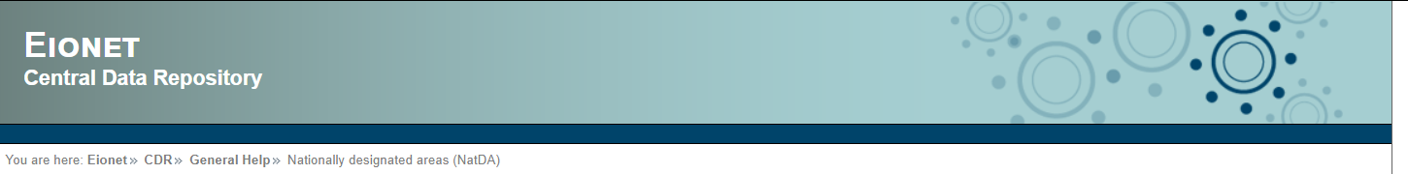
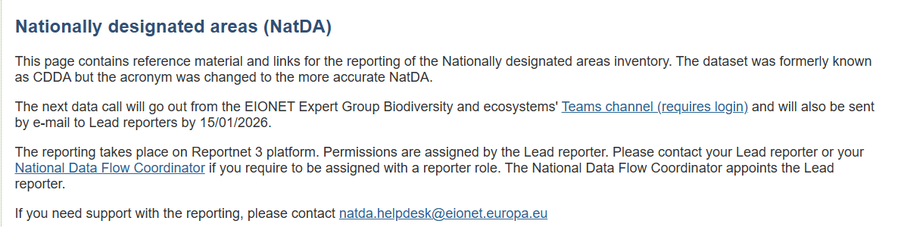
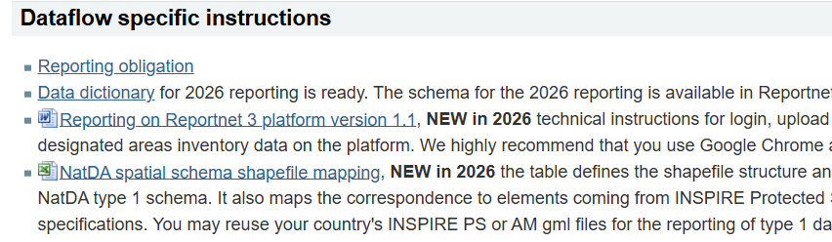
NatDA reference page
Updated
Data Dictionary
Reportnet 3 reporting guidelines
spatial schema file and mapping table
https://cdr.eionet.europa.eu/help/cdda/
© Source

Slide 5
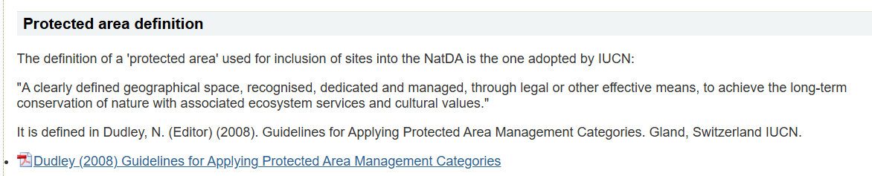
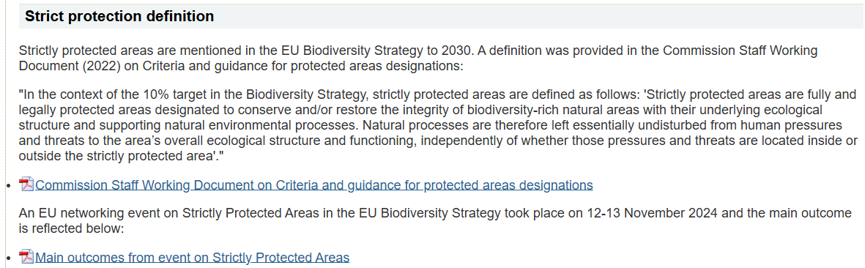
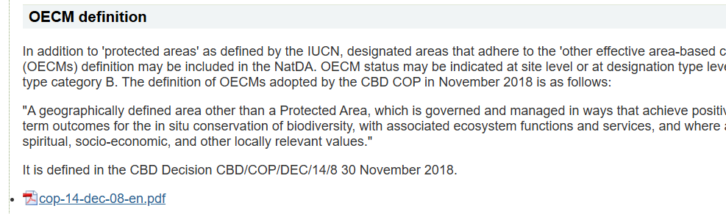
NatDA reference page
Definitions of protected areas, strict protection and OECMs
https://cdr.eionet.europa.eu/help/cdda/
© Source

Slide 6
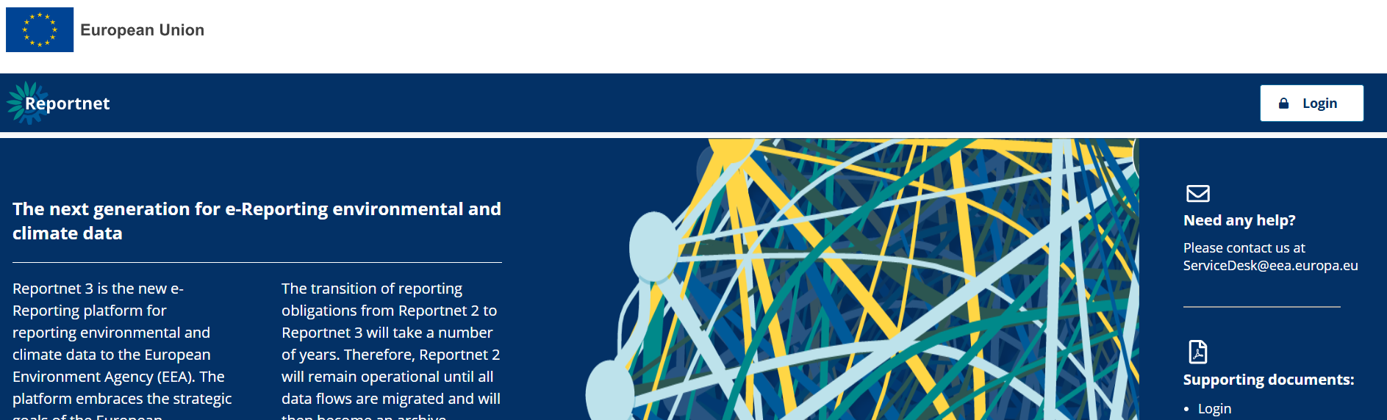
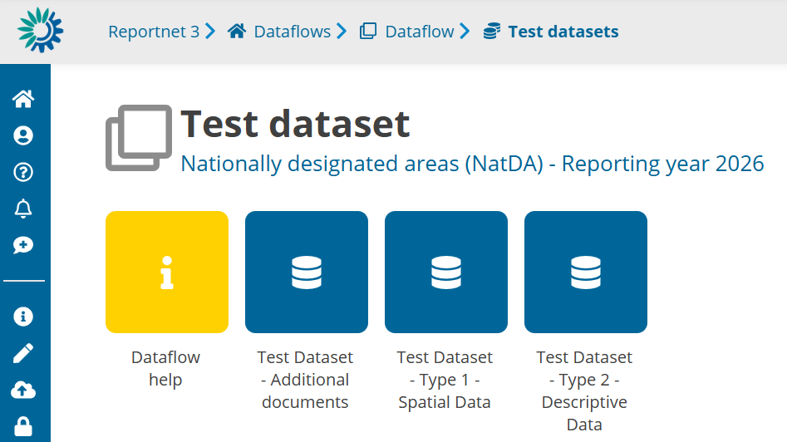
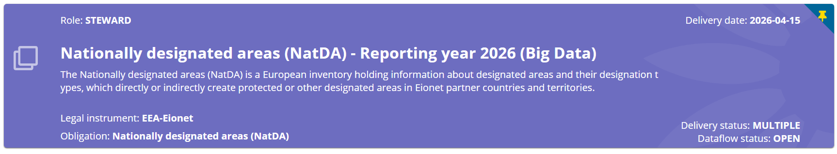
Reportnet 3 platform
2026 NatDA dataflow - https://reportnet.europa.eu/dataflow/1752 (permissions required)
EEA
© Source

Slide 7
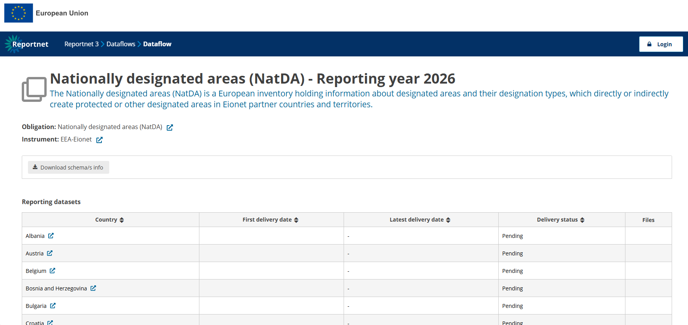
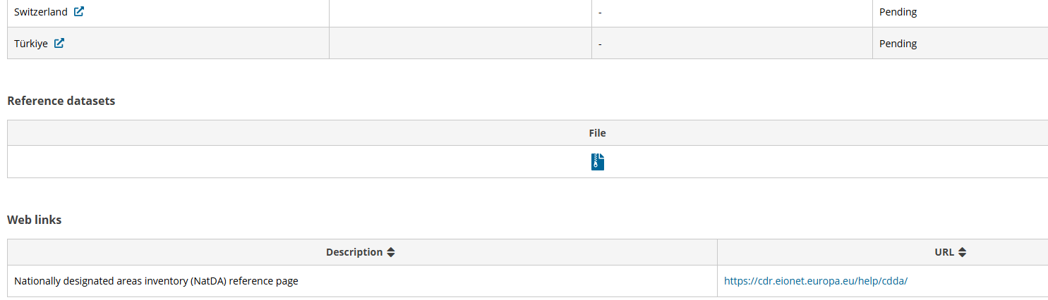
Reportnet 3 platform
2026 NatDA public page, https://reportnet.europa.eu/public/dataflow/1752
© Source

Slide 8
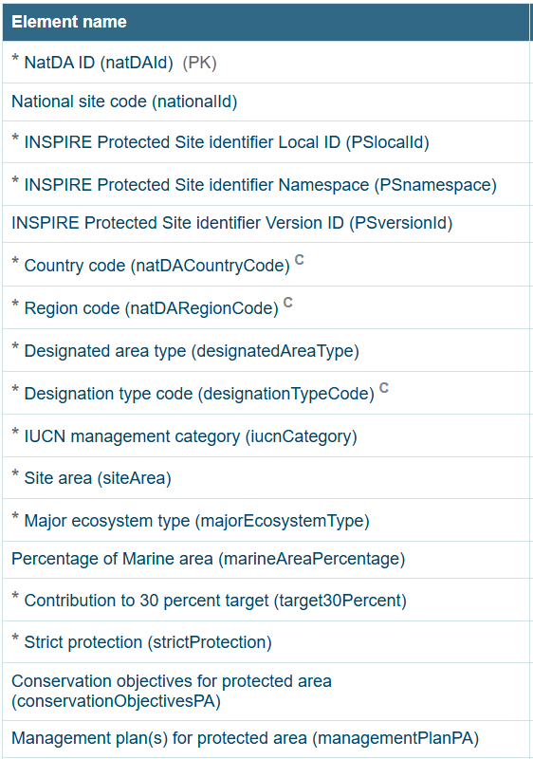
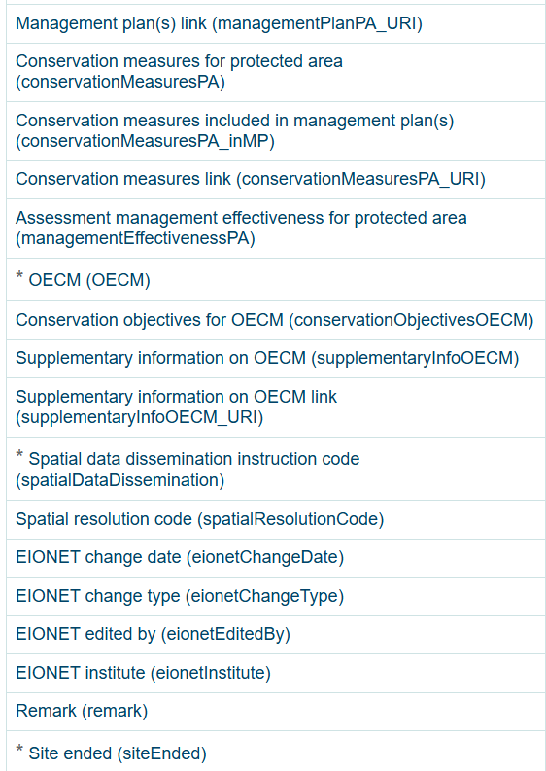
Overview of main changes – table Designated area
New field
Change – field name
New field
New field
New field
New field
Change – field name
New field
Change – field name
New field
Change – new type
New field
Change - two codes
New field
New field
New field
New field
New field
© Source

Slide 9
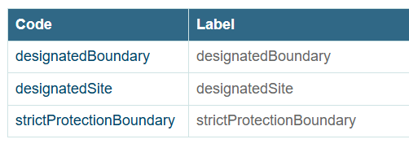
Overview of main changes
Field name changes: NatDA ID, Country code & Region code
  cddaId -> natDAId
  cddaCountryCode -> natDACountryCode
  cddaRegionCode -> natDARegionCode
New type in Designated area type
  ‘strictProtectionBoundary’ is added to the ‘designatedSite’ and ‘designationBoundary’ types
New codes in Designation type codes
  ’xx70’ – “strictly protected”
  ‘xx74’ – OECMs (you may use other names)
Designation types dataflow and webform
https://cdr.eionet.europa.eu/help/designation_types
Designation types dashboard
https://www.eea.europa.eu/en/analysis/maps-and-charts/designation-types-used-by-countries-europe-protected-areas
© Source

Slide 10
Overview of main changes
Mandatory new fields
  Contribution to 30 % target
    Yes / No
  Strict protection
    Yes / No / Partly
  OECM
    Yes / No / Not yet assessed
Optional new fields – still important
  10 in total – aligning with the new SDF or the World Database on Protected and Conserved Areas
    PA conservation objectives and measures, management plans, management effectiveness
    OECM conservation objectives and supplementary info
© Source

Slide 11
Main steps – strict protection
You may report strict protection at the site level or as a multi-polygon
[designatedAreaType] = ‘designatedSite’ or ‘strictProtectionBoundary’
[designatedAreaType] = ‘designatedSite’
  [strictProtection] -> 'yes', 'no', or 'partly'
[designatedAreaType] = ‘strictProtectionBoundary’ (this is a multi-polygon)
  [strictProtection] -> 'yes'
For strictProtectionBoundary use
[designatedTypeCode] = ‘xx70’
[designationTypeName] = “strictly protected”
© Source

Slide 12
Main steps – strict protection
A
B
Boundary of
protected area
Proportion that is strictly protected
strictProtectionBoundary
100% of the site is strictly protected.
e.g. 20% of the site is strictly protected.
© Source

Slide 13
Main steps – OECMs
You may report strict protection at the site level or as a multi-polygon
[designatedAreaType] = ‘designatedSite’ or ‘designatedBoundary’
[designatedAreaType] = ‘designatedSite’
  [OECM] -> 'yes’, ‘no’ or ‘notYetAssessed’
[designatedAreaType] = ‘designatedBoundary’ (this is a multi-polygon)
  [OECM] -> 'yes', ‘no’ or ‘notYetAssessed’
You may use the Designation type code
[designatedTypeCode] = ‘xx74’
[designationTypeName] = “OECM” or another name
© Source

Slide 14
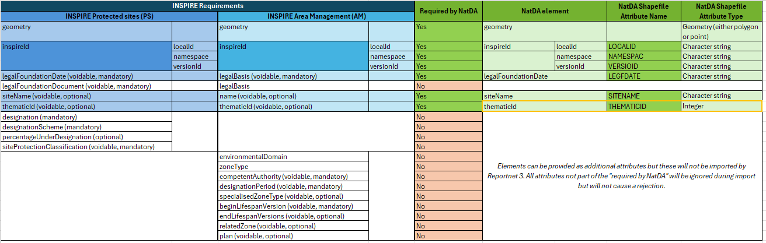
Overview - spatial data
Handing over to Christopher Philipsen, ETC DI
© Source

Slide 15



More questions – open floor
© Pepe Badia Marrero, Environment&Me 2025/EEA

